Slide 1
Energy-Efficient Neuromorphic Computing
MS Project: Mid-Term Presentation
Khritish Kumar Behera
Roll: 17125, Email: khritish17@iiserb.ac.in
Electrical Engineering and Computer Science [EECS] Dept.
Indian Institute of Science Education and Research [IISER] Bhopal
Advisor: Dr. Kuntal Roy, Email: kuntal@iiserb.ac.in

Slide 2
Content
Introduction to Artificial Neural Network
Training and Testing Phase
Perceptron, Activation Function
Forward Propagation
Gradient Descent, Backpropagation
7x5 Character Recognition Model
Neural Network Using Spintronics
Magnetic Anisotropy
Potential Landscape of a Magnet
Magnetic Field applied in the Hard axis and Easy axis
Multiferroics
Design of Neural Network in Hardware
Experimental
Electromagnet
Magnetic Thermal annealing
Gaussmeter

Slide 3
Energy-Efficient Neuromorphic Computing
Spintronics based devices has inherent advantage over transistor:
Weight, Sum and Threshold function
Non-volatile in nature
Y
Piezoelectric
x₁
x₂
x_{n}
.
.
Majority of the Neuromorphic Computing are done on transistor based devices
In terms of Energy dissipation, Transistor have ohmic loss, while spintronics devices does not have ohmic loss
ReadMTJ
Insulator
Magnetostrictive
Write
Non-Boolean Computing

Slide 4
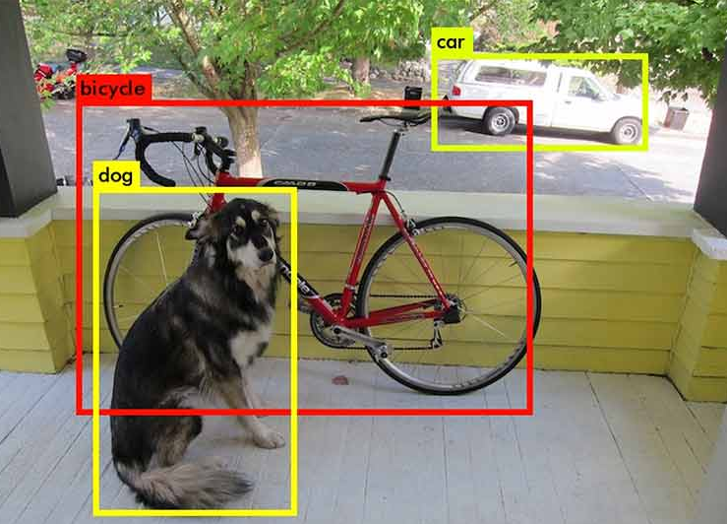

Artificial Neural Network: Motivation
Why Neural Network ?
Rise of Self Driving Car (Tesla)
Object Detection and Object Identification [1]
Face Recognition in Airports
Face detection
Face Recognition [2]

Slide 5
Artificial Neural Network: Training & Testing Phase
Neural Network is a two-phase process
Training Phase
Testing Phase
Training Phase:
The model learns the underlying feature and mapping function of the given input-output data
Testing Phase:
Once the modeled is trained, new input data are feed into the model which were never used in the training phase
Training Data:
( X , T )
X: Input to the model
T: Expected value for input X
Testing is also used for checking whether the model is generalizing the data or its more biased towards the trained data
Input data is feed into the model
The model gives some output form which the error is calculated
Based on the error, the tunning parameter of the model is changed
ERROR: T - O
X
O

Slide 6
Artificial Neural Network: Example
4x4 Character Recognition Model:
Each pixel value (1 or 0) is given to the model as input
The model trains on the training data
Later when test data is given, it gives an accurate result
A
.
.
.
.
.
.

Slide 7
Artificial Neural Network: Perceptron
X1
W1
b
Perceptron is the simplest and most basic form of a neural network
X2
W2
∑
σ
Y
X3
W3
A Simple Perceptron can have more than one input, but the output needs to be just one
Each input edge has a weight associated with it, which can be negative / positive / zero
Each node has a ‘bias’ term associated with it
The Neuron Process through two sequential processes: Summation and Activation

Slide 8
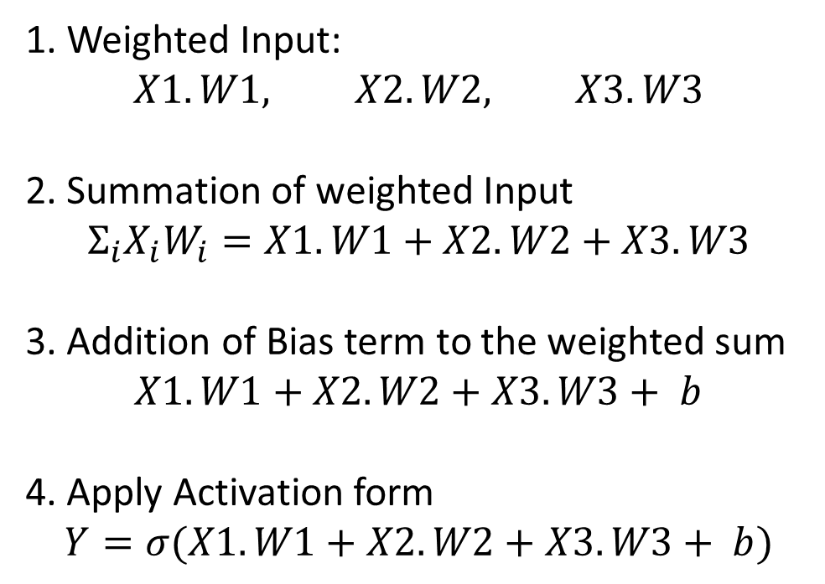
Artificial Neural Network: Perceptron
X1
W1
b
X2
W2
∑
σ
Y
1. Weighted Input:
$$X1.W1, X2.W2, X3.W3$$
2. Summation of weighted Input
$$Σ_{i}X_{i}W_{i}=X1.W1+X2.W2+X3.W3$$
3. Addition of Bias term to the weighted sum
$X1.W1+X2.W2+X3.W3+ b$
4. Apply Activation form
$$Y=σ(X1.W1+X2.W2+X3.W3+ b)$$
X3
W3

Slide 9
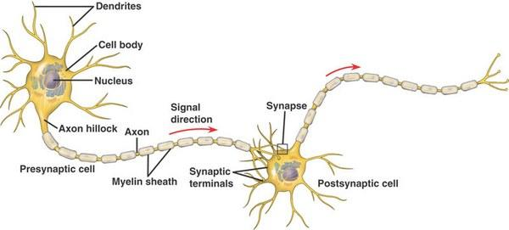
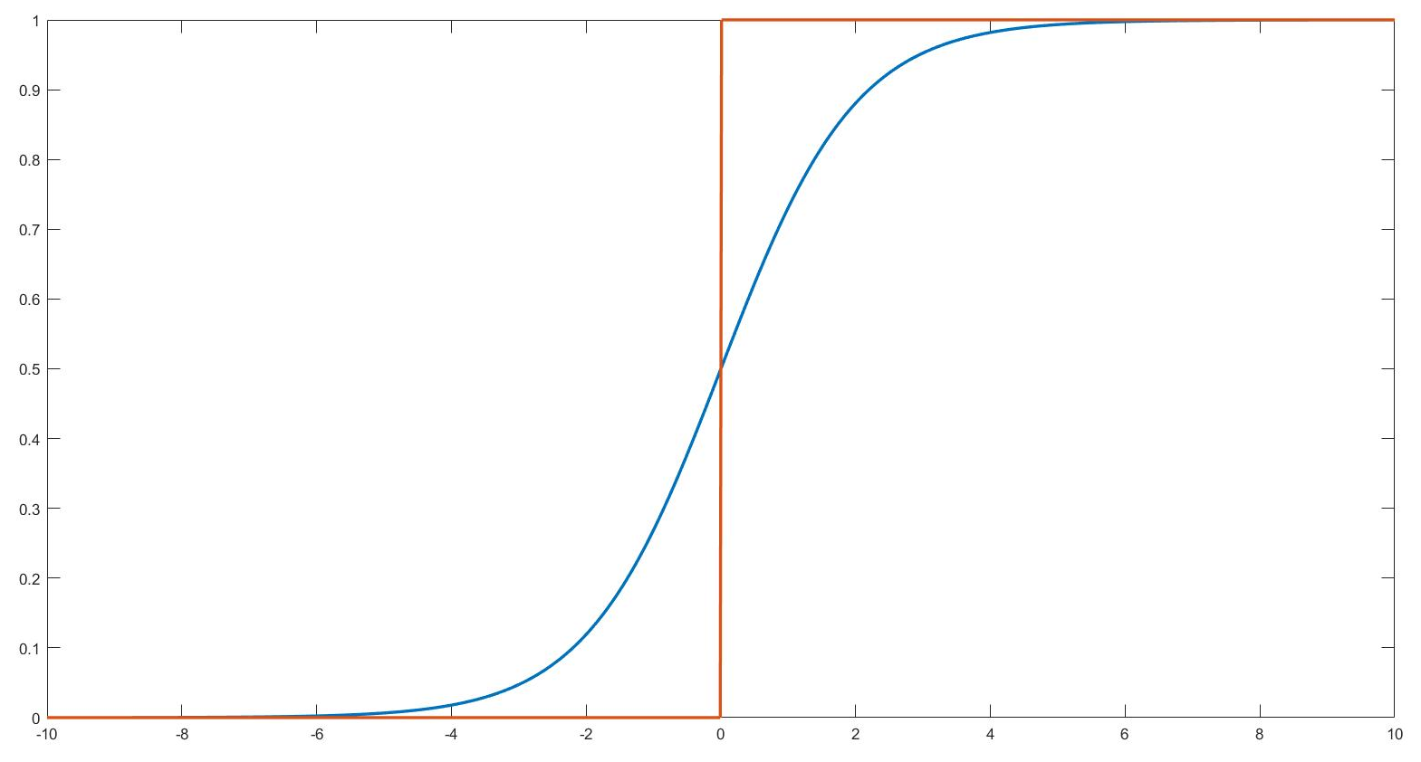
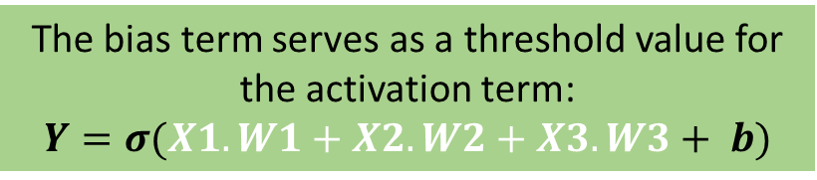
Artificial Neural Network: Activation Function
Activation Function is a non-linear mathematical equation
The bias term serves as a threshold value for the activation term:
$$Y=σ(X1.W1+X2.W2+X3.W3+ b)$$
Activation Function is inspired from biological neuron:
Neurons would not fire and pass the input signal to the next neuron until and unless certain threshold is reached
Bias

Slide 10
Artificial Neural Network: Activation Function
Non-Linearity of Activation Function is the super-power of Artificial Neural Network
Output
Output
Input
Input
The Yellow circle and the red square are linearly classifiable
The Yellow circle and the red square are not linearly classifiable

Slide 11
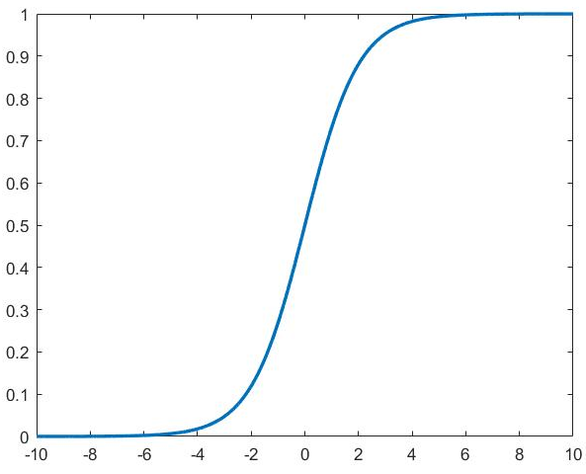
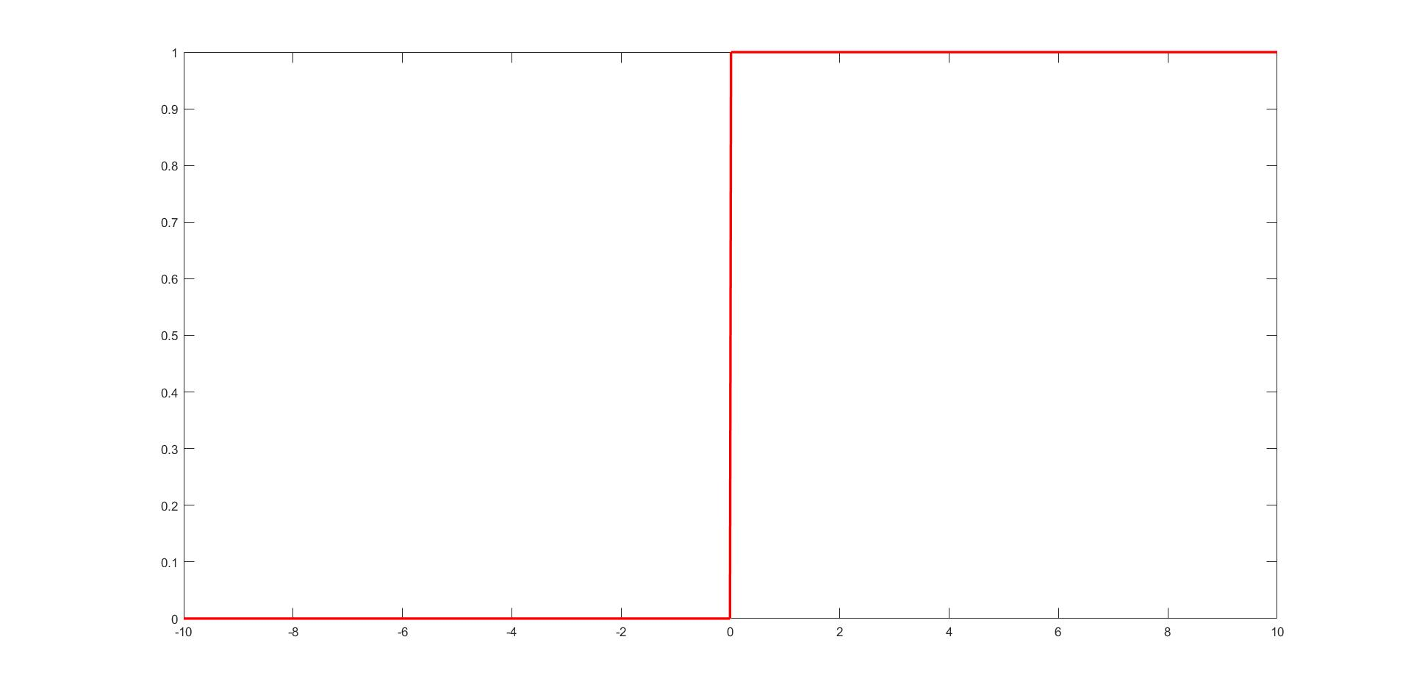
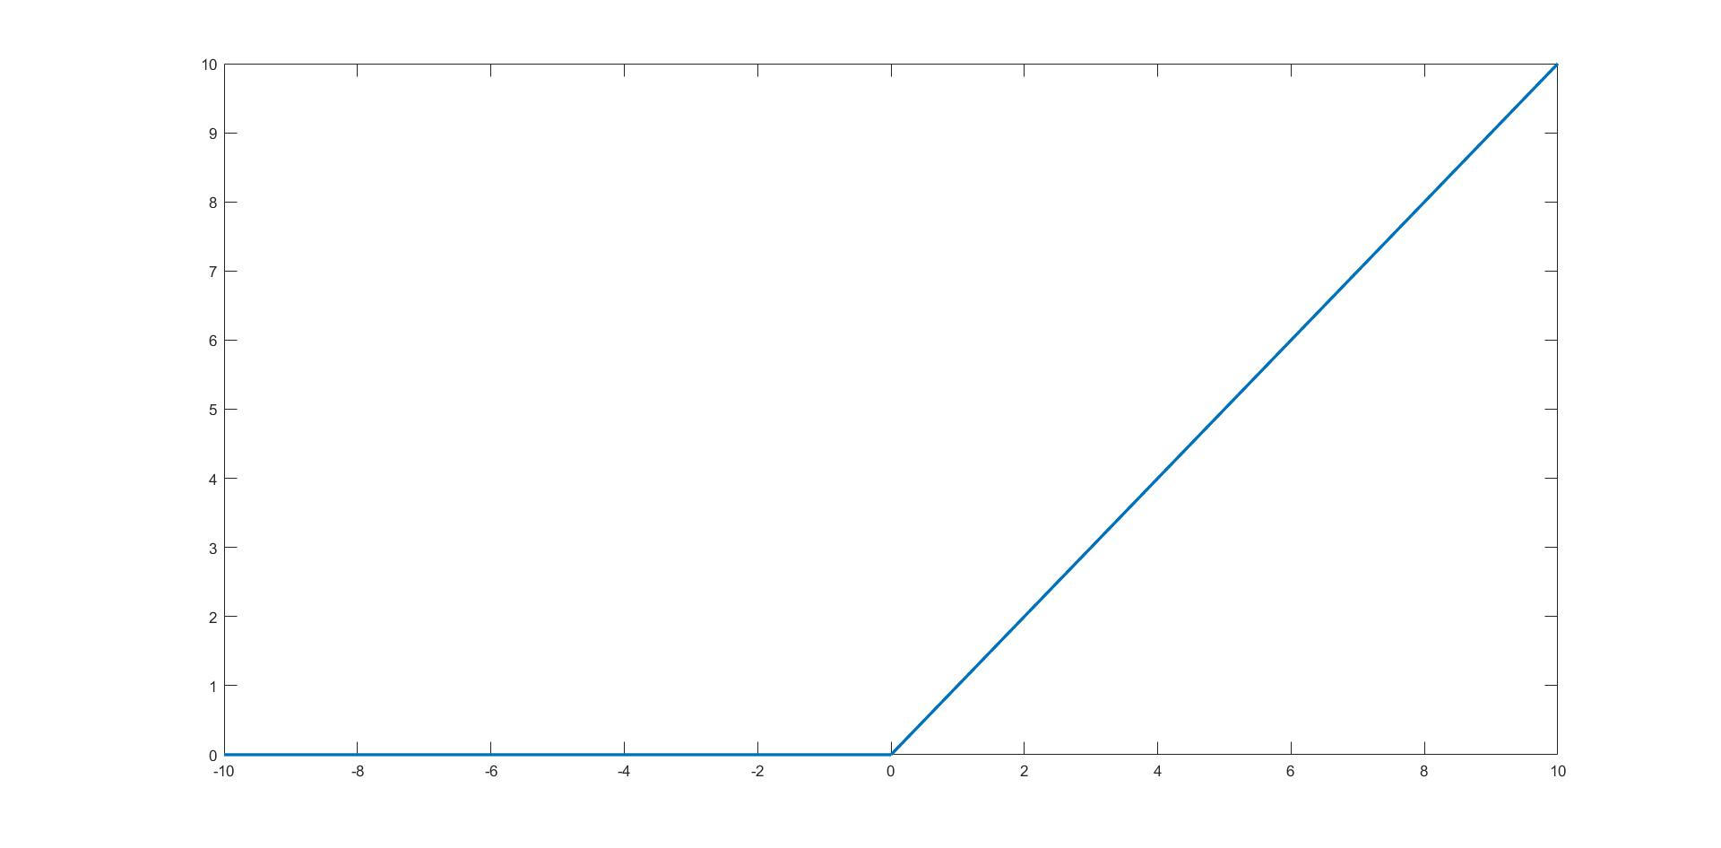
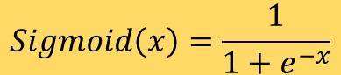
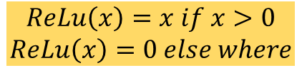
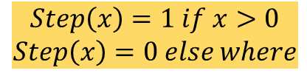
Artificial Neural Network: Activation Function
$$Sigmoid\left(x\right)=\frac{1}{1+e^{−x}}$$
$$Step\left(x\right)=1 if x>0$$
$$Step\left(x\right)=0 else where$$
Rectilinear Unit Function (ReLu)
$$ReLu\left(x\right)=x if x>0$$
$$ReLu\left(x\right)=0 else where$$

Slide 12
Artificial Neural Network: Simple ANN
An Artificial Neural Network is a system of connected artificial neurons
Output of each neuron of one layer is connected to the all of the neurons in the next layer
There are no self loops, no feedback loops
More than one edge emerging out of a neuron, does not mean that there are multiple output of the neuron

Slide 13
Artificial Neural Network: Simple ANN
Input Layer:
Original Input is given here
Neurons simply transfer the input data to next layer without altering the data
No. of neuron depends on the problem requirement
Hidden Layer:
Neurons in the hidden layer alters the input data
At least one hidden layer is required
At least one hidden neuron is required per hidden layer
Hidden Layer:
Neurons in the hidden layer alters the input data
At least one hidden layer is required
At least one hidden neuron is required per hidden layer

Slide 14
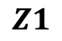
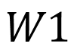
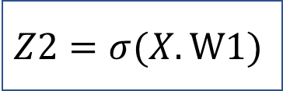
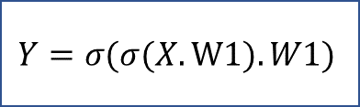
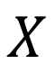
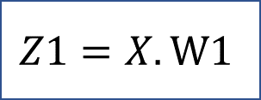
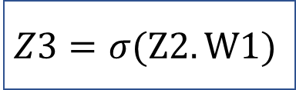
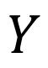
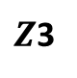
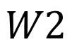
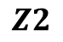
Artificial Neural Network: Forward Propagation
$$W1$$
$$Z1$$
$$Z2$$
$$W2$$
$Z$3
$$X$$
1
2
3
$$Y$$
$$Z1=X.W1$$
$$Z2=σ(X.W1)$$
$$Z3=σ(Z2.W1)$$
$$Y=σ(σ(X.W1).W1)$$

Slide 15
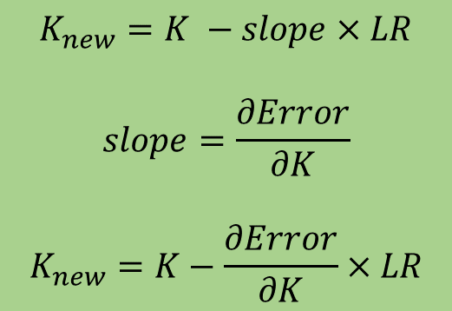
Artificial Neural Network: Gradient Descent
Error
Initial Point
$$K_{new}=K −slope×LR$$
$$slope=\frac{∂Error}{∂K}$$
$$K_{new}=K−\frac{∂Error}{∂K}×LR$$
K (Optimizing Parameter)
LR : Learning Rate

Slide 16
Artificial Neural Network: Gradient Descent
Error
K (Optimizing Parameter)
The Optimizing parameter is always chosen randomly so as to increase the odd of not getting stuck in a local minima
The problem of getting stuck in a local minima is un-avoidable but it can be minimized

Slide 17
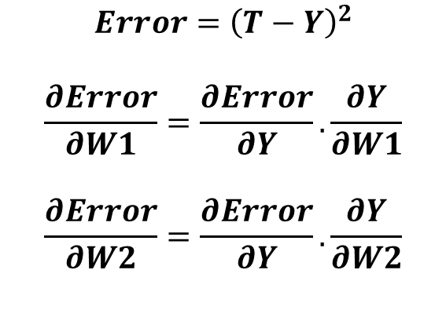
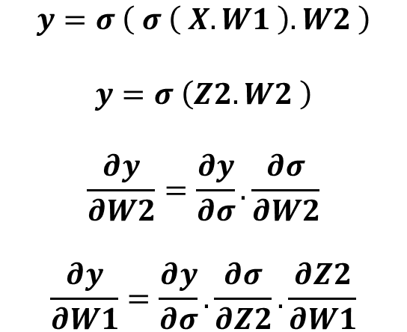
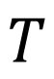
Artificial Neural Network: Backpropagation
$$T$$
Target
$$W1$$
$$Z2$$
$$W2$$
$$X$$
1
2
3
$$Y$$
$$y=σ \left( σ \left( X.W1 \right).W2 \right)$$
$$y=σ \left(Z2.W2 \right)$$
$$\frac{∂y}{∂W2}=\frac{∂y}{∂σ}.\frac{∂σ}{∂W2}$$
$$\frac{∂y}{∂W1}=\frac{∂y}{∂σ}.\frac{∂σ}{∂Z2}.\frac{∂Z2}{∂W1}$$
$$Error={\left(T−Y\right)}^{2}$$
$$\frac{∂Error}{∂W1}=\frac{∂Error}{∂Y}.\frac{∂Y}{∂W1}$$
$$\frac{∂Error}{∂W2}=\frac{∂Error}{∂Y}.\frac{∂Y}{∂W2}$$

Slide 18
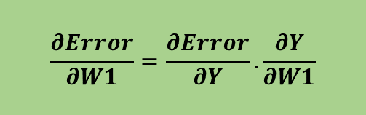

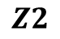

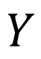
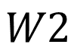
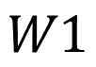
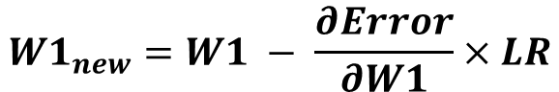
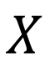
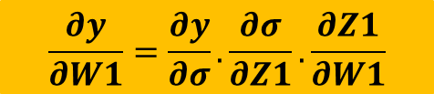
Artificial Neural Network: Backpropagation
$$W1$$
$$Z2$$
$$W2$$
$$X$$
1
2
3
$$Y$$
$$W1$$
$$Z2$$
$$W2$$
$$Y$$
$$X$$
$$σ$$
$$σ$$
Error
$$\frac{∂Error}{∂W1}=\frac{∂Error}{∂Y}.\frac{∂Y}{∂W1}$$
$$\frac{∂y}{∂W1}=\frac{∂y}{∂σ}.\frac{∂σ}{∂Z1}.\frac{∂Z1}{∂W1}$$
$$W1_{new}=W1 − \frac{∂Error}{∂W1}×LR$$

Slide 19
Artificial Neural Network: Character Recognition
We wish to create an ANN which can recognize alphabets from a noisy 7x5 pixel binary pattern
A
A

Slide 20
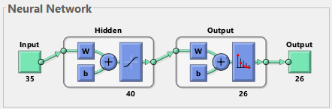
Artificial Neural Network: Neural Architecture
Input:
35-Bit word of the test character
Output:
26-Bit word suggesting the character
A: 1,0,0,0,0,0,0,0,…..0,0,0,0
B: 0,1,0,0,0,0,0,0,……0,0,0,0
C: 0,0,1,0,0,0,0,0,……0,0,0,0
Similarly others

Slide 21
Artificial Neural Network: Setting Neural Architecture
Challenge is to set the number of hidden layers and the number of neurons per hidden layer
Testing Error
Error
Training Error
To find the optimal number of neuron for a hidden layer:
Calculate the testing and training error for neuron starting from 1 to max number of neurons (which is computationally feasible)
Plot the Error of testing and training against number of hidden neurons
Consider only those neuron as optimal, where the testing error curve has a minima
Error Gap
Neurons no.
Optimizing number of neurons in hidden layer
To find the optimal number of hidden layer:
Start from first hidden layer, calculate the no. of hidden neurons required and then check the error gap
Calculate the no. of neurons for the second layer and then check the error gap
If the error gap increased after adding the new layer, stick with the old architecture else keep on adding new layer until the error gap increases
Error Gap:
(Testing Error – Training Error)
at the optimal hidden neuron

Slide 22
Artificial Neural Network: Noise Tolerance
4 BIT FLIP
5 BIT FLIP
6 BIT FLIP
ORIGINAL
Correct Prob. = 0.913
Wrong Prob. = 0.087
Correct Prob. = 0.7942
Wrong Prob. = 0.2058
Correct Prob. = 0.7077
Wrong Prob. = 0.2923
Test Data with mix noises varying from 4-bit to 8-bit Results:
Correct Prob. = 0.7203
Wrong Prob. = 0.2797
8 BIT FLIP
7 BIT FLIP
On an average up to 6-bit noise are decently handled by the ANN
8-Bit noise results in low accuracy
Correct Prob. = 0.5923
Wrong Prob. = 0.4077
Correct Prob. = 0.4635
Wrong Prob. = 0.5365

Slide 23
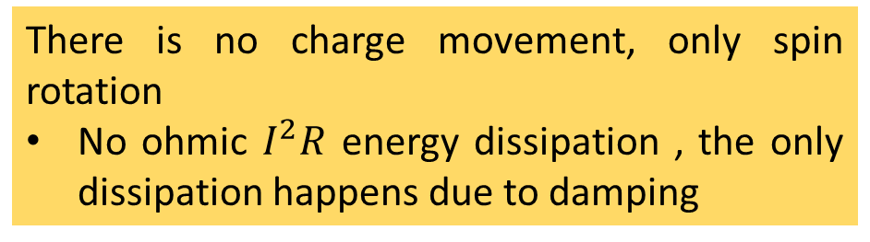
Spintronics: Spin-Electronics
Spin
Spin
Charge
Spin Up (↑) / Down (↓)
0 / 1
Electron
Spintronics device are non-volatile and endurable
Which gives an advantage over transistor, since transistor requires extra circuitry to have the non-volatile nature
Apart from having charge, electron also has a spin
There is no charge movement, only spin rotation
No ohmic $I^{2}R$ energy dissipation , the only dissipation happens due to damping

Slide 24
Content
Introduction to Artificial Neural Network
Training and Testing Phase
Perceptron, Activation Function
Forward Propagation
Gradient Descent, Backpropagation
7x5 Character Recognition Model
Neural Network Using Spintronics
Magnetic Anisotropy
Potential Landscape of a Magnet
Magnetic Field applied in the Hard axis and Easy axis
Multiferroics
Design of Neural Network in Hardware
Experimental
Electromagnet
Magnetic Thermal annealing
Gaussmeter

Slide 25


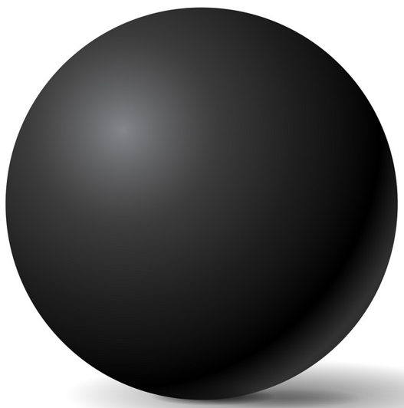
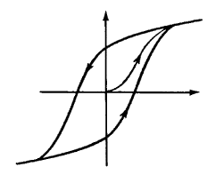
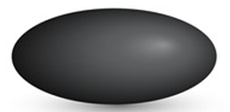
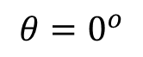
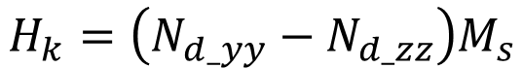
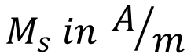
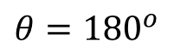
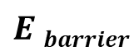
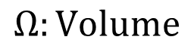
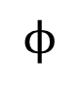
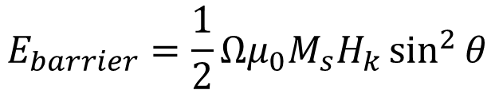
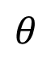
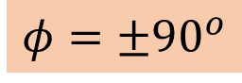
Magnetic Anisotropy
30-80 KT at 300 K
x
In-plane
Shape anisotropy
Magnetization
$$E barrier$$
$$ϕ$$
$$θ$$
z
CoFeB
y
$$φ=±90^{o}$$
$$H_{k}=\left(N_{d_yy}−N_{d_zz}\right)M_{s}$$
$$θ={180}^{o}$$
$$θ=0^{o}$$
$$E_{barrier}=\frac{1}{2}Ωμ_{0}M_{s}H_{k}\sin^{2}{θ}$$
M
Sphere
$$Ω:Volume$$
$$M_{s} in A/m$$
H
H_{k}
Ellipsoid

Slide 26
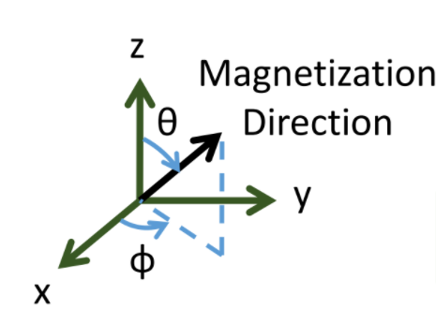






Potential Landscape of Magnet
$$E_{shape}\left(θ,φ\right)=\frac{1}{2}μ_{0}M_{s}\left[H_{k}+ H_{d}\cos^{2}{φ}\right]Ω\sin^{2}θ$$
$$H_{k}=\left(N_{d_yy}−N_{d_zz}\right)M_{s}$$
$$H_{d}=\left(N_{d_xx}−N_{d_yy}\right)M_{s}$$
$$M_{s}=8×{10}^{5}\frac{A}{m}$$
$$\left(a,b,t\right)=\left(100nm, 90nm, 6nm\right)$$
$$N_{d}=(0.8529, 0.0788, 0.0683)$$
$$θ ( in degree)$$
$$φ ( in degree)$$

Slide 27








Magnetic Field applied along in-plane hard axis
$$E=\frac{1}{2}μ_{0}M_{s}H_{k}\sin^{2}{θ−μ_{0}M_{s}H_{y}\sin{θ }}$$
$$\frac{dE}{dθ}=0$$
$$\sin{θmin=\frac{H_{y}}{H_{k}} }$$
$$θmin=\sin^{−1}\left(\frac{H_{y}}{H_{k}}\right)$$
Magnetic Field applied along Y-axis
$$θ (degree)$$

Slide 28



Magnetic Field applied along in-plane Easy axis
$$E=\frac{1}{2}μ_{0}M_{s}H_{k}\sin^{2}{θ−μ_{0}M_{s}H_{z}\cos{θ }}$$
$$θmin=\sin^{−1}\left(\frac{H_{y}}{H_{k}}\right)$$
Magnetic Field applied along Z-axis
$$θ (degree)$$

Slide 29








Magnetostriction
Magnetostrictive Material : Certain ferromagnetic specimen changes its shape (strain: $\frac{∂l}{l}$) during the process of magnetization and the phenomenon is known as Magnetostriction
$λ:$ Magnetostriction Co-efficient
Magnetostrictive Anisotropy ↔ Stress Anisotropy
$$\frac{3}{2}λ σ Ω {Cos}^{2}θ$$
$$σ:Stress$$
$$Ω:Volume$$
Cobalt:
$$\frac{3}{2}λ=30×{10}^{−6}$$
FeGa:
$$\frac{3}{2}λ=150×{10}^{−6}$$
$$σ=Y.\left(strain\right)$$
$$=Yd\frac{V}{t}$$
$$d=3000\frac{pm}{V}$$
$$Y=250×{10}^{9} Pa$$
$$t=100 nm$$
Stress Anisotropy (for FeGa):
$\frac{3}{2}λ σ Ω {Cos}^{2}θ$
$=2.4×{10}^{−18} T$ (max.)

Slide 30



Multiferroics
Multiferroic
P
M
E
H
E
Ferroelectric
Multiferroic
and magnetoelectric
Ferromagnetic
Piezoelectricity
Magnetoelectricity (intrinsic)
P
P, M
$$ε$$
M
E, H
$$σ$$
H
Magnetostriction
$$\boxed{α_{ME}=μ_{0}\frac{∂M}{∂E}}$$

Slide 31

Design of Neural Network
Electric Potential
Stress in Piezoelectric
Stress in Magnetostrictive
Changes magnetization of Magnetostrictive
Changes the magnetization direction in the lower plate of TMR
Creates different resistance
ReadMTJ
Insulator
Magnetostrictive
Write
x₁
w₁
w₂
y = f(u)
Piezoelectric
x₂
$$Σ$$
.
.
.
w_{n}
x₁
f
x₂
x_{n}
Neuron
x_{n}
.
.

Slide 32
Content
Introduction to Artificial Neural Network
Training and Testing Phase
Perceptron, Activation Function
Forward Propagation
Gradient Descent, Backpropagation
7x5 Character Recognition Model
Neural Network Using Spintronics
Magnetic Anisotropy
Potential Landscape of a Magnet
Magnetic Field applied in the Hard axis and Easy axis
Multiferroics
Design of Neural Network in Hardware
Experimental
Electromagnet
Magnetic Thermal annealing
Gaussmeter

Slide 33
Experimental
Electromagnet for magnetic alignment
Magnetic Thermal Annealing for better magnetic characterization
Gaussmeter for measuring the magnetic field
Sputtering for deposition of different materials, e.g., piezoelectric, magnets
Electron Beam Lithography (EBL) for patterning single-domain nanomagnets
Magnetic Force Microscopy (MFM) for visualizing single-domain nanomagnets
Ferromagnetic Resonance (FMR) for characterizing the magnetic damping parameter
Vibrating Sample Magnetometer (VSM) for magnetic hysteresis

Slide 34



Experimental: Electromagnet
Chiller
Constant Current
Power Supply
Magnetic Coil
Gauss Probe
Magnetic Coil: When electric current is passed through the magnetic coils it generates a constant magnetic field
Gauss Probe: It is used to measure the magnetic field generated between the poles
Constant Current Power Supply: Provides a constant current to the magnetic coil which in turn a constant magnetic field between the poles
Chiller: When the electromagnet is in working condition the coil generates a lot of heat, which might damage the coil, to reduce the temperature of the coil, chiller provides cold water over the coil in order to absorb the heat generated from the coil, Min. $1^{0}$ cool water can be sent by the chiller

Slide 35





Experimental: Magnetic Thermal Annealing
Heater
Enhances the magnetic property of magnetic materials
MTA Setup
The heating of the magnetic material above its recrystallization temperature in a magnetic field and then cooling will allow atom migration within the crystal lattice such that the number of dislocation sites decreases, leading to the change in magnetic properties
Vacuum Pump
Magnetic Thermal Annealing is done at very low pressure iz. around in orders of ${10}^{−2}$ mBar, for which we required a vacuum pump and Pirrani Gauze to provide real time pressure value
For heating the sample, a heater is used

Slide 36


Experimental: Gaussmeter
Gauss Probe
Gaussmeter is a static electronic magnetic field measurement device
The Gaussmeter has two probes:
Axial Probe: Which measures the magnetic field parallel to the probe
Transversal Probe: Which measures the magnetic field perpendicular to the probe
It measures by the Hall effect, which is the conversion of magnetic field into Hall Voltage
Electrons in magnetic field tries to move in perpendicular direction of applied magnetic field (Lorentz force)

Slide 37










Experimental: Gaussmeter
H↑
$$θ→$$
R = 2.5cm : $0^{0}<θ<{360}^{0}$
H↑
H↑
$$θ→$$
$$θ→$$
R = 3.6cm : $0^{0}<θ<{360}^{0}$
R = 5cm : $0^{0}<θ<{360}^{0}$

Slide 38










Experimental: Gaussmeter
H↑
$φ$→
R = 2.5cm : $0^{0}<φ<{360}^{0}$
H↑
H↑
$φ$→
$φ$→
R = 3.6cm : $0^{0}<φ<{360}^{0}$
R = 5cm : $0^{0}<φ<{360}^{0}$

